Slide 1
Tools of the Trade – Web Development
Adele Igel
Assistant Professor
University of California, Davis

Slide 2
Why Do I Want a Webpage?
Make it easy for people to find out more about you
Highlight your accomplishments
Blogs
Experience with HTML
For fun!

Slide 3
How Do I Get a Web Address?
Find out if your university provides one
Ask your advisor to host your page on theirs
3rd party hosts (e.g. Wordpress)

Slide 4
What Information Should I Put on My Webpage?
Anything you want! Within reason.
Short biography
Why you are interested in meteorology
Your research interests
Class projects
Links to published papers
Be careful about providing published paper directly – check copyright regulations
Copy of your resume or CV

Slide 5

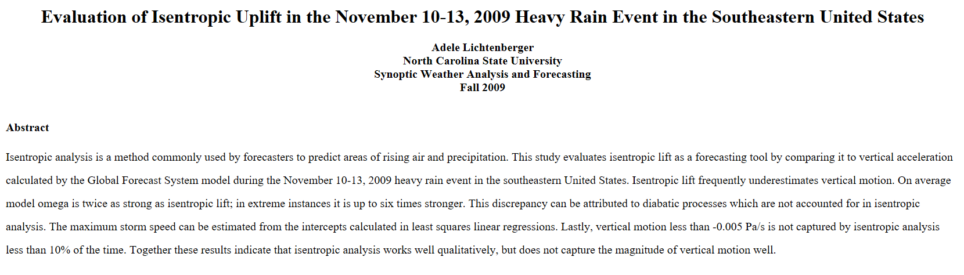
It Doesn’t Have to Be Fancy
My first web page - Hosted by my university

Slide 6
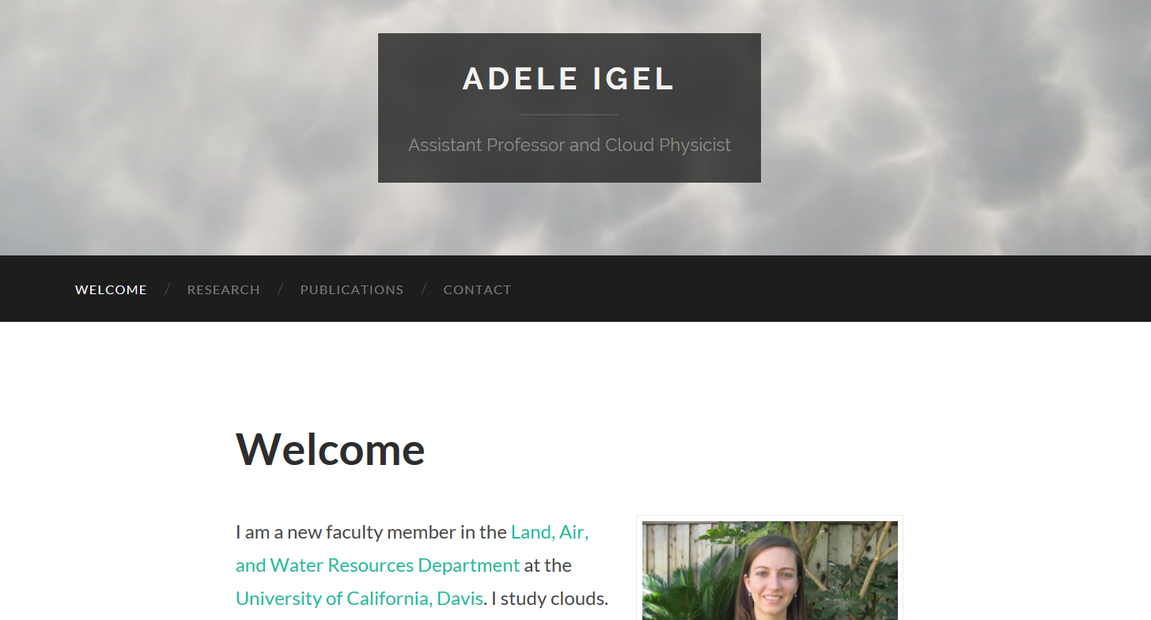
…But It Easily Can Be
Wordpress hosted through my university

Slide 7
Use Templates!
Wordpress Templates
Pros: No need to know any HTML!
Cons: Hard to make the layout customized
Many freely available templates on the web
Pros: Highly customizable
Cons: Need to know some HTML coding
Fully Responsive Templates
Work on mobile devices, tablets, and full size desktop screens

Slide 8
Basics
HTML files
Where you put all of your content
CSS file
Where you tell the webpage how to look
Colors, sizes, fonts, positions, etc
Lots of websites and books available to teach yourself HTML and CSS
w3schools.com

Slide 9
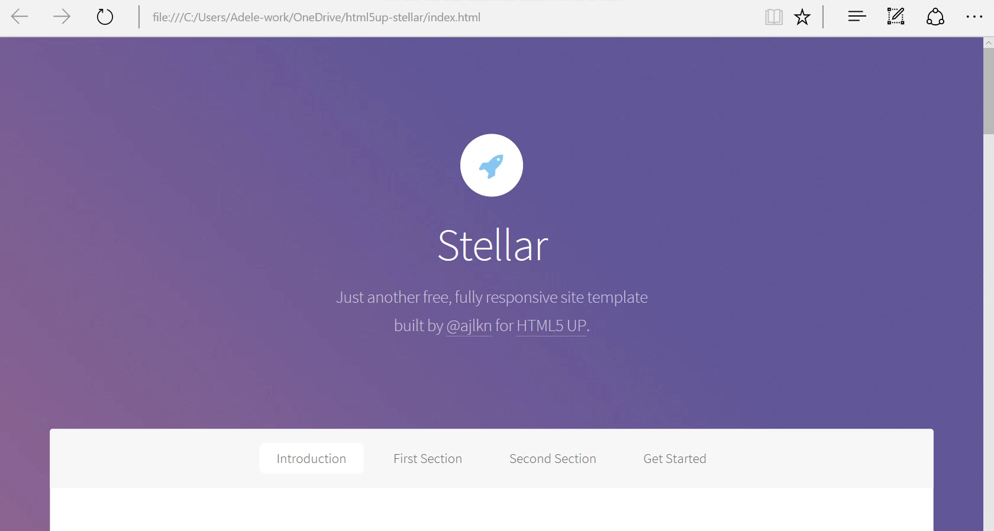
Get Started!
f

